Slide 1
Endocrine Problems

Slide 2
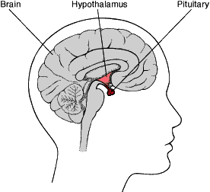
Disorders of the Anterior Pituitary
Growth hormone (GH)
  Promotes protein synthesis
  Mobilizes glucose & free fatty acids
  Overproduction almost always caused by benign tumor (adenoma)

Slide 3
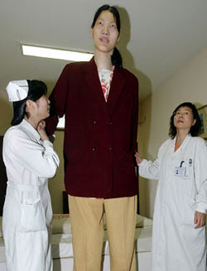
Gigantism
In children excessive secretion of GH
Occurs prior to closure of the epiphyses & long bones still capable of longitudinal growth
Usually proportional
May grow as tall as 8 ft & weigh >300 lb

Slide 4
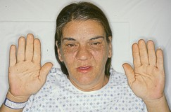
Acromegaly
In adults excessive secretion of GH stimulates IGF-1 (Liver). NO negative feedback with tumor.
Overgrowth of bones & soft tissues
Bones are unable to grow longer—instead grow thicker & wider
Rare—3 out of every million
M=F

Slide 5
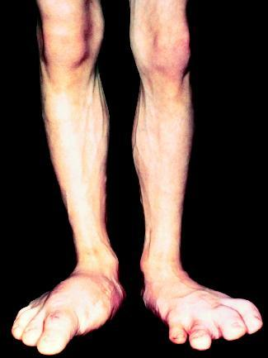
Continued Clinical Manifestations
Visual disturbances & HA from pressure of tumor
Hyperglycemia
Predisposes to atherosclerosis
Untreated causes angina, HTN, lt ventricular hypertrophy, cardiomegaly

Slide 6
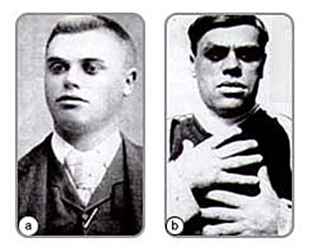
Progression of Acromegaly

Slide 7
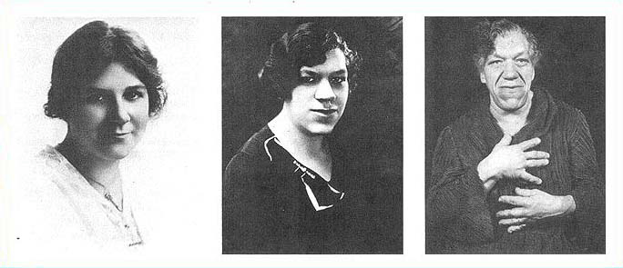
Progression of acromegaly

Slide 8
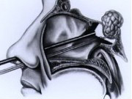
Removal of tumor transsphenoidal approach
Hypophysectomy—removal of entire gland with lifetime hormone replacement

Slide 9
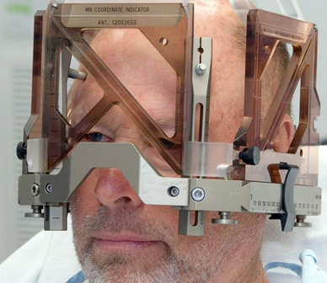
Head frame for stereotactic radiosurgery

Slide 10
Treatments
Drug therapy
  Somatostatin analogs
    Octreotide (Sandostatin)—given SQ 2-3 x weekly
  Dopamine agonist
    Cabergoline (Dostinex)—tried first due to low cost, but not as effective
  GH receptor antagonists
    Pegvisomant (Somavert)—not for primary tx—does not act on tumor

Slide 11
Treatments
Somatropin (Omnitrope)—GH for long-term replacement—given daily SQ @ HS

Slide 12
Review question
A person suspected of having acromegaly has an elevated plasma GH Level. In acromegaly, one would also expect the person’s diagnostic results to include:
  A. Hyperinsulinemia
  B. A plasma glucose of less than normal.
  C. Decreased GH levels with an oral glucose challenge test
  D. A serum somatomedin C (IGF-1) of higher than normal

Slide 13
Answer
d. A nl response to GH secretion is stimulation of the liver to produce somatomedin C, or insulin-like growth factor-1 (IGF-1), which stimulates growth of bones & soft tissues. The increase levels of somatomedin C normally inhibit GH, but in acromegaly, the pituitary gland secretes GH despite elevated IGF-1 levels. When both GH & IGF-1 levels are increased, overproduction of GH is confirmed. GH also causes elevation of blood glucose, & normally GH levels fall during an oral glucose challenge but not in acromegaly.

Slide 14
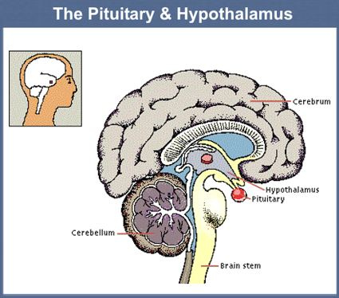
Hypofunction of pituitary gland
Hypopituitarism
  Rare disorder
  Decrease of one or more of the pituitary hormones
  Secreted by post pit:
    ADH, oxytocin
  Secreted by ant pit:
    ACTH, TSH, follicle-stimulating (FSH) luteinizing hormone (LH), GH & prolactin

Slide 15
Etiology & Pathophysiology
Causes of pituitary hypofunction
  Tumor (most common)
  Infections
  Autoimmune disorders
  Pituitary infarction (Sheehan syndrome)
  Destruction of pituitary gland (radiation, trauma, surgery)
Deficiencies can lead to end-organ failure

Slide 16
Clinical Manifestations
Tumor
  Space- decrease peripheral vision or acuity, anosmia (loss of sense of smell), seizures
GH deficiency
  Decreased muscle mass, truncal obesity, flat affect
FSH & LD deficiencies
  Menstrual irregularities, dec libido, changes sex characteristics
ACTH & cortisol deficiency
  Fatigue, weakness, dry & pale skin, postural hypotension, fasting hypoglycemia, poor resistance to infection
Men with FSH & LD deficiencies
  Testicular atrophy, dec spermatogenesis, loss of libido, impotence, dec facial hair & muscle mass

Slide 17
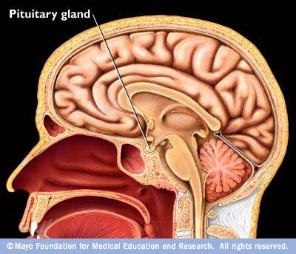
Syndrome of inappropriate antidiuretic hormone (SIADH)
Overproduction of ADH or arginine vasopressin (AVP)
Synthesized in the hypothalamus
Transported & stored in the posterior pituitary gland
Major role is water balance & osmolarity

Slide 18
Pathophysiology of SIADH
Increased antidiuretic hormone (ADH)→
Increased water reabsorption in renal tubules→
Increased intravascular fluid volume→
Dilutional hyponatremia & decreased serum osmolality

Slide 19
SIADH
ADH is released despite normal or low plasma osmolarity
S/S:
  Dilutional hyponatremia
  Fluid retention
  Hypochloremia
  Nl renal function, <U/O
  Concentrated urine
  Serum hypoosmolality
S/S: cerebral edema, lethargy, confusion, seizures, coma

Slide 20
Causes of SIADH
Malignant Tumors
  Sm cell lung CA
  Prostate, colorectal, thymus CA
  Pancreatic CA
CNS Disorders
  Brain tumors
  Lupus
  Infections: meningitis
  Head injury: skull fx, subdual hematoma
Misc conditions
  HIV
  Lung infection
  hypothyroidism
Drug therapy
  Oxytocin
  Thiazide diuretics
  SSRIs
  Tricyclic antidepressants
  opioids

Slide 21
Diagnostic studies & Treatment
Simultaneous measurements of urine and serum osmolality
Na <134 mEq/L
Urine specific gravity > 1.005
Serum osmolality < 280 mOsm/kg (280 mmol/kg)
Treatment
  Treat underlying cause
  Restore nl fluid volume & osmolality
  Restrict fluids to 800-1000cc/day if Na >125 mEq/L & Lasix
  Serum Na <120 mEq/L, seizures can occur, tx with hypertonic Na+ solution (3%-5%) slowly

Slide 22
Diabetes Insipidus (DI)
Deficiency of production or secretion of ADH OR a decreased renal response to AHD
Results in fluid & electrolyte imbalances
Types of DI
  Central DI (neurogenic DI)
  Nephrogenic DI

Slide 23
Pathophysiology of DI
Decreased ADH→
Decrease water absorption in renal tubules→
Decreased intravascular fluid volume→
Excessive urine output resulting in increased serum osmolality (hypernatremia)

Slide 24
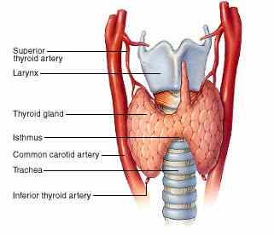
Thyroid gland disorders
Thyroid hormones (T3 & T 4) regulate energy metabolism and growth and development

Slide 25
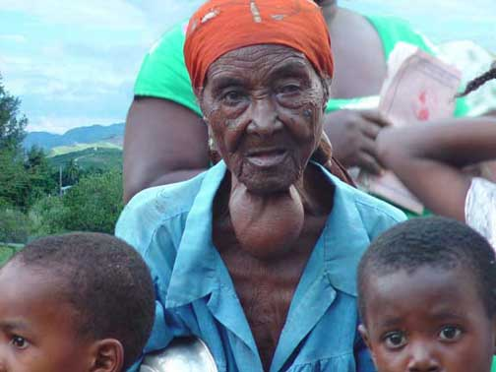
Thyroid enlargement
Goiter—hypertrophy & enlargement of thyroid gland
Caused by excess TSH stimulation
Can be caused by inadequate circulating thyroid hormones

Slide 26
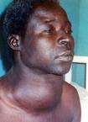
Thyroid enlargement
Found in pts with Graves’ disease
Persons that live in a iodine-deficient area (endemic goiter)
Surgery is used to remove large goiters

Slide 27
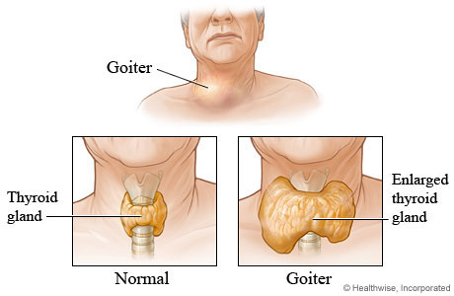
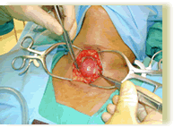
Enlargement of the thyroid gland
TSH & T4 levels are used to determine if goiter is associated with hyper-/hypo- or normal thyroid function
Check thyroid antibodies to assess for thyroiditis

Slide 28
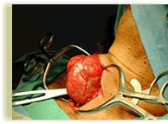
Treatment of Nodules
US
CT
MRI
Fine-needle aspiration (FNA)—one of the most effective methods to identify malignancy
Serum calcitonin (increased levels associated with CA)

Slide 29
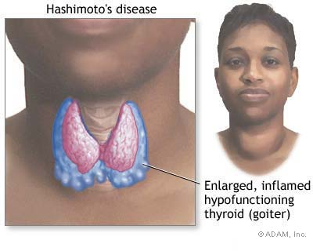
thyroiditis
Inflammation of thyroid
Chronic autoimmune thyroiditis (Hashimoto’s disease)—nl tissue replaced by lymphocytes & fibrous tissue
Causes
  Viral
  Infection bacterial
  Fungal infection

Slide 30
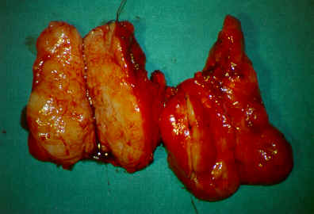
Dx studies & management of thyroiditis
Dx studies
  T3 & T4 initially elevated and then may become depressed
  TSH levels are low and then elevated
  TSH high & dec hormone levels in Hashimoto’s thyroiditis

Slide 31
Treatment of thyroiditis
Recovery may take weeks or months
Antibiotics or surgical drainage
ASA or NSAIDS—if doesn’t respond in 50 hours, steriods as used
Propranolol (Inderal) or atenolol (Tenormin) for elevated heart rates
More susceptible to Addison’s disease, pernicious anemia, Graves’ disease, gonadal failure

Slide 32
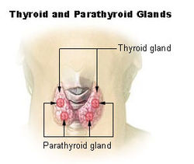
hyperthyroidism
Hyperactivity of the thyroid gland with sustained increased in synthesis & release of thyroid hormones
M>W
Peaks in persons 20-40 yrs old
Most common type is Graves’ disease

Slide 33
Graves’ disease
Autoimmune disease
Unknown etiology
Excessive thyroid secretion & thyroid enlargement
Precipitating factors: stressful life events, infection, insufficient iodine supply
Remissions & exacerbations
May progress to destruction of thyroid tissue
75% of all hyperthyroidism cases
Pt has antibodies to TSH receptor

Slide 34
Toxic nodular goiters
Function independent of TSH stimulation
Toxic if associated with hyperthyroidism
Multinodular goiter or solitary autonomous nodule
Benign follicular adenomas
M=W
Seen peak >40 yr of age
Nodules >3 cm may result in clinical disease

Slide 35
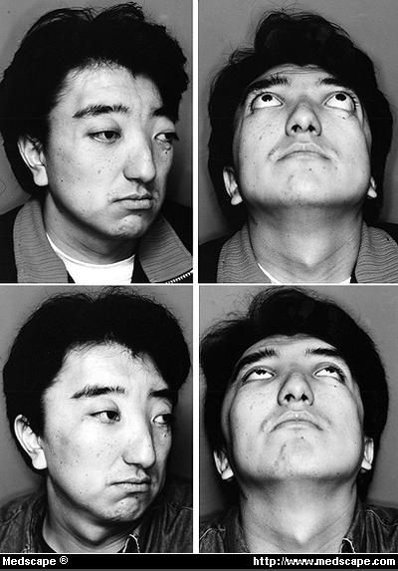
Clinical manifestations
Bruit present
Ophthalmopathy—abnl eye appearance or function
Exophthalmos—protrusion of eyeballs from orbits—20-40 % of pts
Usually bil, but unilateral or asymmetric

Slide 36

Clinical manifestations
Weight loss
Apathy
Depression
Atrial fibrillations
Confusion
Increased nervousness

Slide 37
Diagnostic studies
TSH—decreased
Elevated free T4 (free is the form of hormone that is biologically active)
RAIU (radioactive iodine uptake) test—Graves’ uptake 35-95%; thyroiditis uptake < 2%)
ECG
Ophthalmologic examination
TRH stimulation tests

Slide 38
Collaborative care
Goal: block adverse effects of hormones & stop oversecretion
Iodine: used with other drugs to prepare for OR or tx of crisis—1-2 wks max effect
Antithyroid drugs:
  Propylthiouracil (PTU)—has to be taken TID
  Methimazole (Tapazole)
Total or subtotal thyroidectomy
B-adrenergic blockers—symptomatic relief
  Propranolol (Inderal)
  Atenolol (Tenormin)—used in pts with heart disease or asthma

Slide 39
Collaborative care
Radioactive Iodine Therapy—treatment of choice for non-pregnant women; damages or destroys thyroid tissues; max effect seen in 2-3 months; post hypothyroidism seen in 80% of patients
Nutritional therapy:
  High-calories: 4000-5000 kcal/day
  Six meals a day
  Snacks high in carbs, protein
  Particularly Vit A, B6, C & thiamine
  Avoid caffeine, high-fiber, highly seasoned foods

Slide 40
hypothyroidism
Common medical disorder in US
Insufficient circulating thyroid hormone
Primary—related to destruction of thyroid tissue or defective hormone synthesis
Can be transient
Secondary—related to pituitary disease or hypothalamic dysfunction
Most common cause iodine deficiency or atrophy thyroid gland (in US)
May results from tx of hyperthyroidism
Cretinism hypothyroidism in infancy

Slide 41
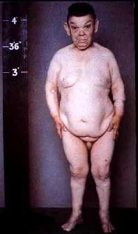
hypothyroidism
Cretinism—hypothyroidism that develops in infancy
All newborns are screened at birth for hypothyroidism

Slide 42
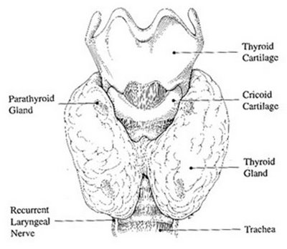
Clinical manifestations
S/S vary on severity of deficiency, age onset, patient’s age
Nonspecific slowing of body processes
S/S occur over months or years
Long-termed effects more pronounced in neurologic, GI, cardiovascular, reproductive & hematologic sytems

Slide 43
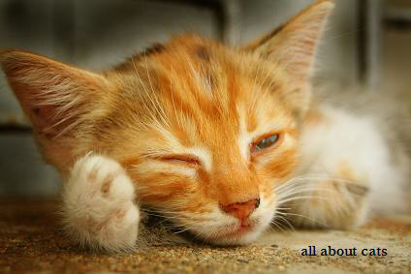
Clinical manifestations
Fatigue
Lethargy
Somnolence
Decreased initiative
Slowed speech
Depressed appearance
Increased sleeping
Anemia

Slide 44
Clinical manifestations
Decreased cardiac output
Decreased cardiac contractility
Bruise easily
Constipation
Cold intolerance
Hair loss
Dry, course skin
Weight gain
Brittle nails
Muscle weakness & swelling
Hoarseness
Menorrhagia
Myxedema—occurs with long-standing hypothyroidism

Slide 45
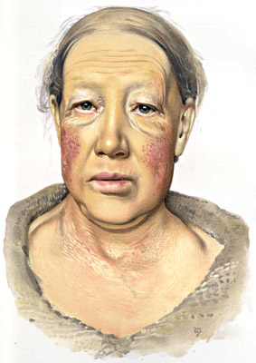
Clinical manifestations
Puffiness
Periorbital edema
Masklike effect
Coarse, sparse hair
Dull, puffy skin
Prominent tongue

Slide 46
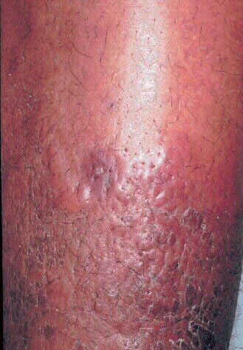
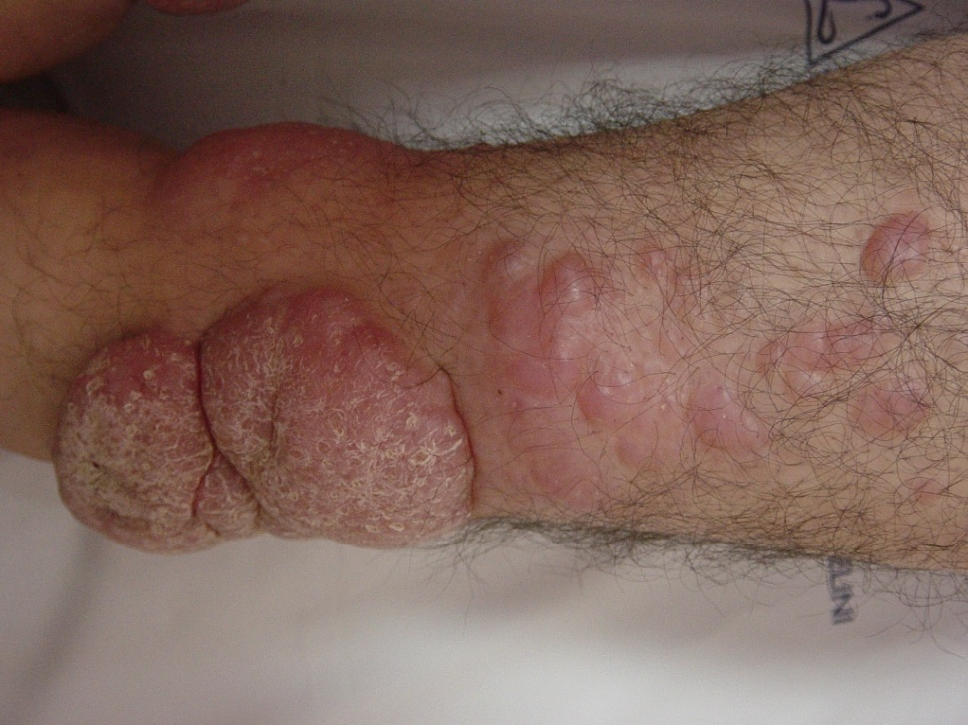
More myxedema

Slide 47
Complications of hypothyroidism
Myxedema coma:
  Medical emergency
  Mental drowsiness, lethargy & sluggishness may progress to a grossly impaired LOC
  Hypotension
  Hypoventilation
  Subnormal temperature

Slide 48
Testing & treatment
Serum TSH is high
Free T4
Hx & physical
Cholesterol (elevated)
Triglycerides (elevated)
CBC (anemia)
CK (increased)
Levothyroxin (Synthroid)
  Levels are checked in 4-6 wks and dosage adjusted
  Take meds regularly
  Lifelong treatment
  Monitor pts with CAD
  Monitor HR & report to HCP >100 bpm
  Promptly report chest pain, weight loss, insomnia, nervousness

Slide 49

Expected outcomes
Adhere to lifelong therapy
Have relief from symptoms
Maintain an euthyroid state as evidenced by nl TSH levels
Severe myxedema of leg→→→→→→→→

Slide 50
Disorders of the adrenal cortex
Main classifications of adrenal cortex steriod hormones:
  Mineralocorticoid
    Regulates K+ & sodium balance
  Androgen
    Contribute to growth & development in males/females & sexual activity in adult women
  Glucocorticoid
    Cortisol is primary one
    regulate metabolism, increase glu levels, critical in physiologic stress response

Slide 51
Cushing syndrome
Caused by excess of corticosteriods, more specifically: glucocorticoids
Hyperfunction of adrenal cortex
Women>Men
20-40 yrs age group
Other causes:
  ACTH-secreting pituitary tumor (Cushing’s disease)
  Cortisol-secreting neoplasm in adrenal cortex
  Prolonged high doses of corticosteriods
  CA of lungs or malignant growth

Slide 52
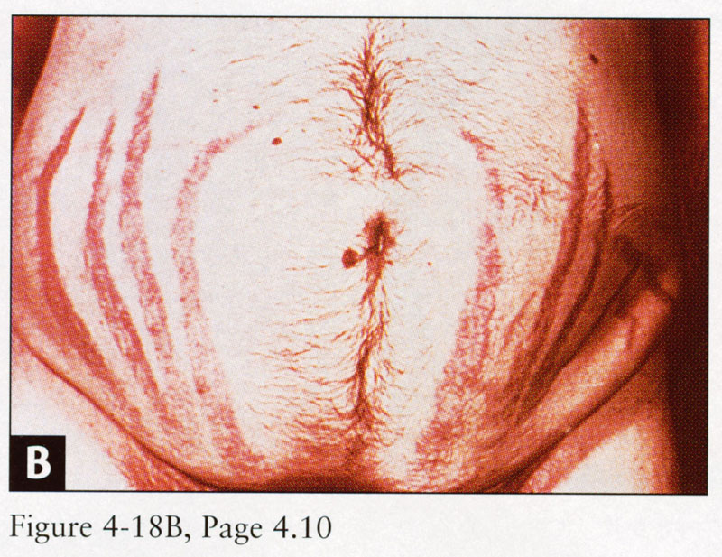
Clinical manifestations of Cushing
Thin, fragile skin
Poor wound healing
Acne—red cheeks
Purplish red striae
Bruises
Fat deposits on back of neck & shoulders (buffalo hump)

Slide 53
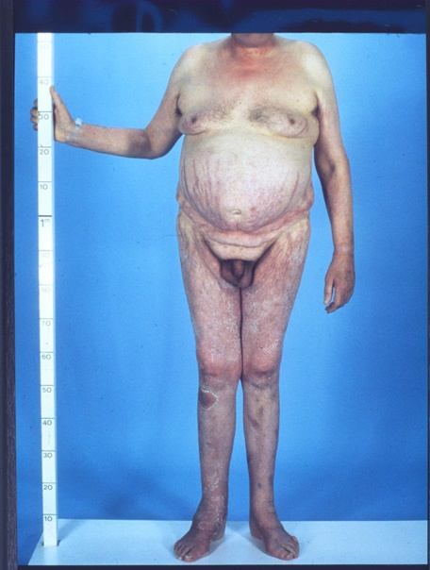
Clinical manifestations of Cushing
Thin extremities with muscle atrophy
Pendulous abd
Ecchymosis—easy bruising
Weight gain
Increased body & facial hair
Supraclavicular fat pads

Slide 54
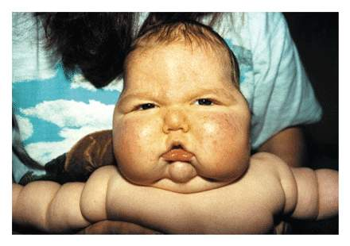
Clinical manifestations of cushing
Rounding of face (moon face)
HTN, edema of extremities
Inhibition of immune response
Sodium/water retention
This infant had a 3 pound weight gain in 1 day→→

Slide 55
Diagnostic studies for cushing
24-hr urine for free cortisol (50-100 mcg/day)
Plasma cortisol levels may be elevated
High-dose dexamethasone suppression test (false-positive results with depression, acute stress, active alcoholics)
CBC—leukocytosis
CMP—hyperglycemia, hypokalemia
Hypercalciuria
Plasma ACTH level
History and physical

Slide 56
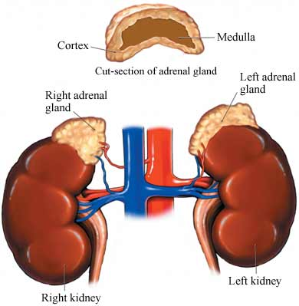
Treatment of cushing syndrome
Adrenalectomy (open or laparoscopic)
If caused by steriod tx, taper & discontinue
Drug therapy:
  Metyropone
  Mitotane (Lysodren)—”medical adrenalectomy”
  Ketoconazole (Nizoral)
  Aminoglutethimide (Cytadren)

Slide 57
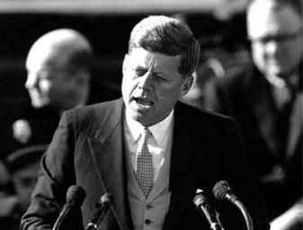
Hypofunction of adrenal cortex—addison’s disease
All 3 classes of adrenal corticosteriods are reduced
Most common cause is autoimmune response
Other causes: AIDS, metastatic cancer, TB, infarction, fungal infections
M=W (JFK had Addison’s)
Occurs in <60 yrs of age

Slide 58
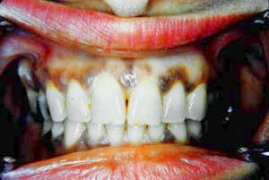
Clinical manifestations of addison’s
Bronzed or smoky hyperpigmentation of face, neck, hands (esp creases), buccal membranes, nipples, genitalia
Anemia, lymphocytosis
Depression
Delusions

Slide 59
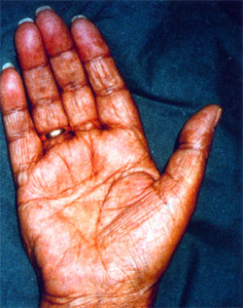
Clinical manifestations of addison’s
Fatigability
Tendency toward coexisting autoimmune diseases
N/V/D, abd pain
Hypotension
Vasodilation
Weight loss
Hyponatremia, dehydration

Slide 60
Diagnostic studies & treatment
CT scan
MRI
ACTH-stimulations test
History & physical
Plasma cortisol levels
Serum electrolytes
CBC
Urine for free cortisol (will be low)
Q day glucocorticoid (hydrocortisone) replacement (2/3 upon awakening & 1/3 in evening)
Salt additives for excess heat or humidity
Daily mineralocorticoid in the am
Increased doses or cortisol for stress situations (OR, hospitalizations)

Slide 61
Side effects of corticosteroids
Hypocalcemia R/T anti-vitamin D effect
Weakness & skeletal muscle atrophy
Predisposition to peptic ulcer disease (PUD)
Hypokalemia
Mood & behavior changes
Predisposes to DM
Delayed healing
HTN→predisposes to heart failure
Protein depletion predisposes to pathologic fx esp compression fx of vertebrae

Slide 62
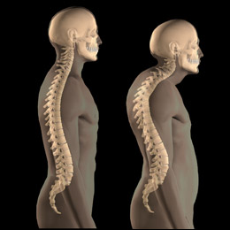
Complications of steriod therapy
Steriods taken for longer than 1 week will suppress adrenal production
Always wean steriods, do not abruptly stop
Take early in the am with food

